Slide 1
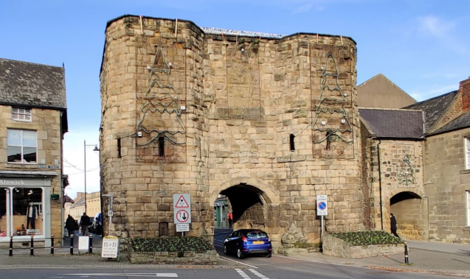
Bondgate Tower, Alnwick Traffic Management Study

Slide 2
Bondgate Tower - Issues
15th Century Gatehouse of significant historic interest.
Scheduled Ancient Monument and Grade 1 listed.
Owned by Northumberland Estates but straddles the public highway.
Listed on Historic England’s “Heritage at risk register” - classed as in ‘very bad condition’.
Subject to at least eight vehicle strikes since 2003.
Evidence of other, more minor impacts.
Impact on the wider road network when closed.

Slide 3
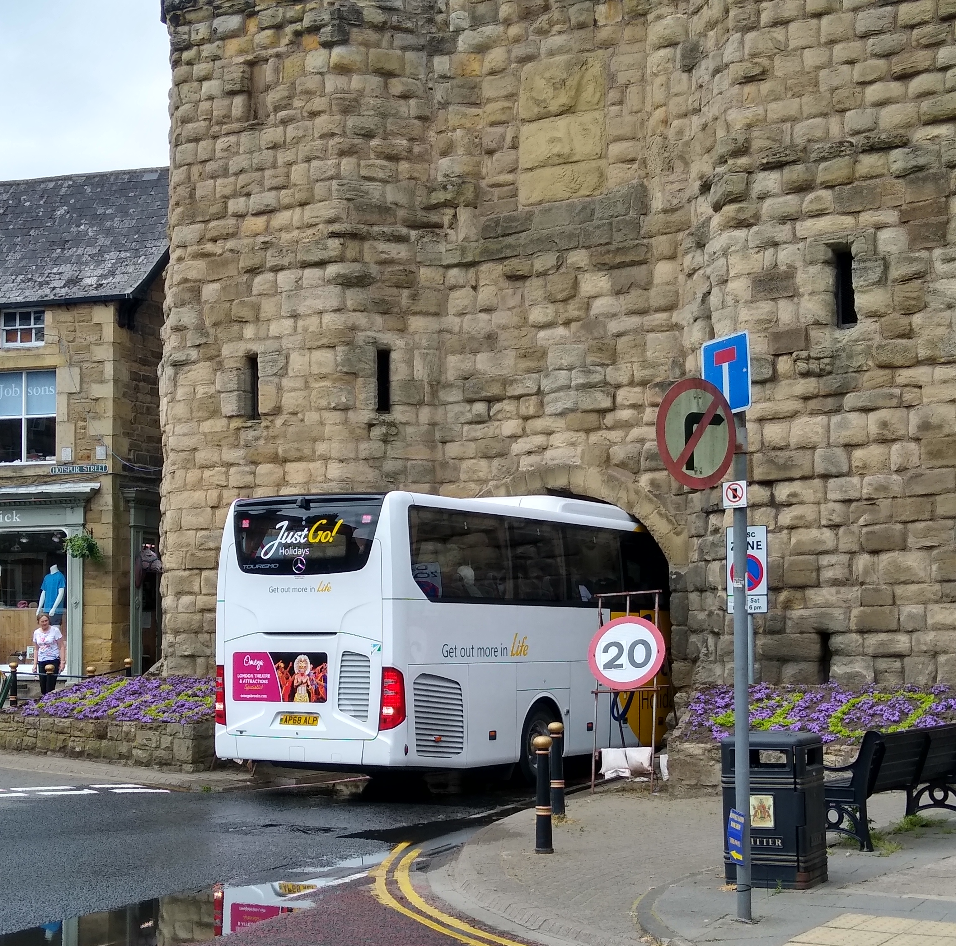
Vehicle Strikes
Eight known strikes since 2003.
Evidence of more frequent impacts.
Significant cost of repairs.
Significant disruption to road network.
Additional traffic on surrounding residential streets.
Effect on the town centre economy.
June 2021

Slide 4
Traffic Management Study - Requirements
Assess the current warning signage and recommend any appropriate changes.
Set out what further measures could be installed to prevent further vehicle strikes.
Assess the impact of closing the tower to all vehicles on traffic flows within and around the town.
Assess the impact of closing the tower to all vehicles on the alternative routes.
Consider whether any wider traffic management measures could be placed on the wider highway network to divert through traffic away from the tower, the town centre or the town as a whole.

Slide 5
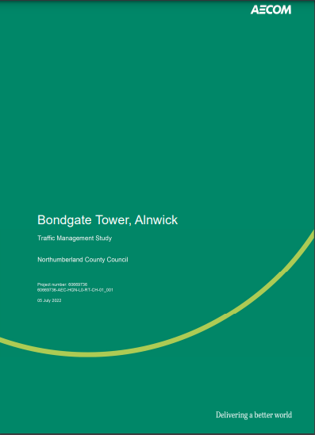
Traffic Management Study Report
Site visits
Accident data analysis
Traffic data collection and analysis
Review of signage
Option development and analysis
Recommendations

Slide 6
Accident Data Analysis
Five year period 2016 to 2021.
28 collisions recorded during this period: 0 fatal, 4 serious & 24 slight.
Compares well with similar areas – collision severity is significantly lower than the national average for built-up areas.
No ‘clusters’.
No patterns.
No ‘injury’ accidents at Bondgate Tower.

Slide 7
Traffic Flows
New traffic and turning counts collected at 8 locations.
At the busiest peak hour observed during the study, over 850 vehicles passed through the tower in one hour, (Saturday, November).
Busier summer months estimated to be around 8% higher, resulting in up to 1,000 vehicles per hour.
The greatest flow is eastbound (leaving the town centre).
Significantly more traffic uses the B6346 via the tower than uses the diversion routes (Green Batt and Lisburn Street).

Slide 8
Proposed Options
Option 1 – Signage
Option 2 – Closure to traffic in one direction
Option 3 – Full closure to traffic.
Additional options
Height detection technology and interactive signs
Kerb realignment

Slide 9
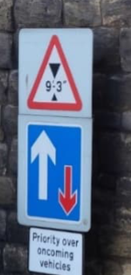
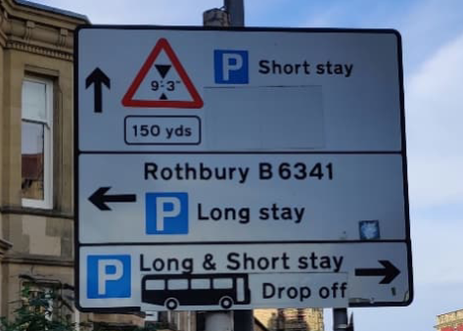
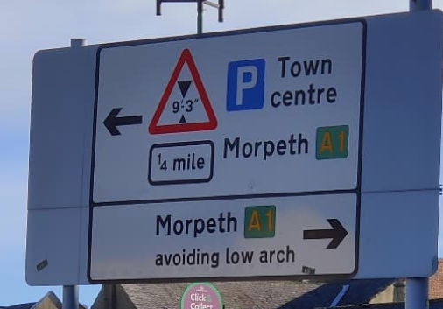
Option 1: Signage
9’ 3” height restriction currently in place.
Signs at the tower itself and on the approaches:

Slide 10
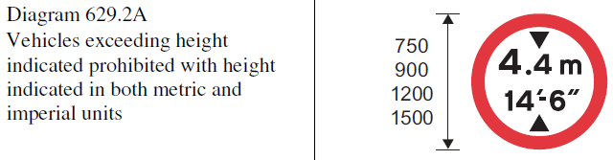
Existing height restriction warning signs should be replaced with more appropriate mandatory signs which are enforceable.
Provide 'missing' signage on approach from Eglingham.
Provide additional "last chance" signs within the town centre, if appropriate.
New signs include metric measurements as well as imperial.

Slide 11
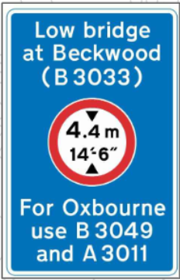
New advance warning signs on all approaches to show height restriction and alternative route In addition to revised versions of the existing signage.

Slide 12
Benefits of revised signage
Clear and comprehensive information for height restricted vehicles on all approaches.
Closing existing “gaps” by which high vehicles could find themselves at the tower without passing a warning sign and providing additional signs as reminders at the last turning points.
Reduction of cognitive overload risk via additional warnings of the height restriction separate from ADS.
Replacement of warning signage with enforceable and unambiguous regulatory signage.
Opportunity to update superseded imperial unit only signage with current imperial and metric layout, which may be of use to foreign coaches and HGVs visiting Alnwick.

Slide 13
Option 2: Closure to traffic in one direction
Tower closed to north/westbound traffic (towards the town centre).
Traffic can be easily diverted into Hotspur Street.
Avoids need for potential U-turns in Bondgate Within if closure is reversed.
Road layout is simplified, reducing confusion and allowing greater focus on the height restriction itself.
Assumed to half the potential for vehicle strikes.
Junction layout at Bondgate Without/Hotspur Street changed.
Results in additional traffic on alternative routes.

Slide 14
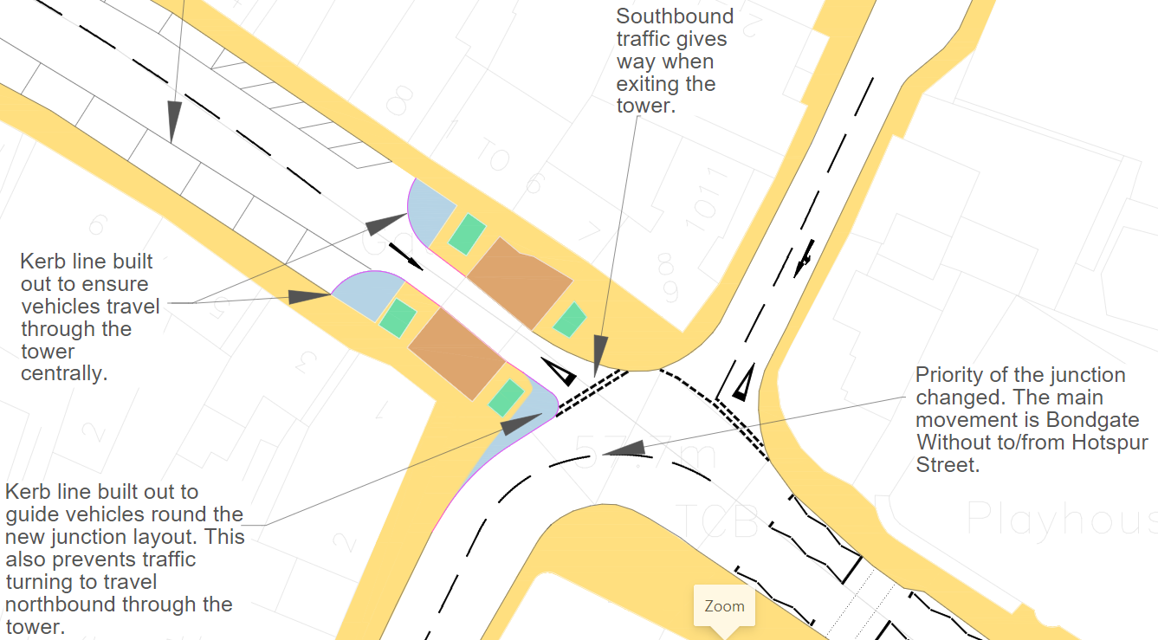

Slide 15
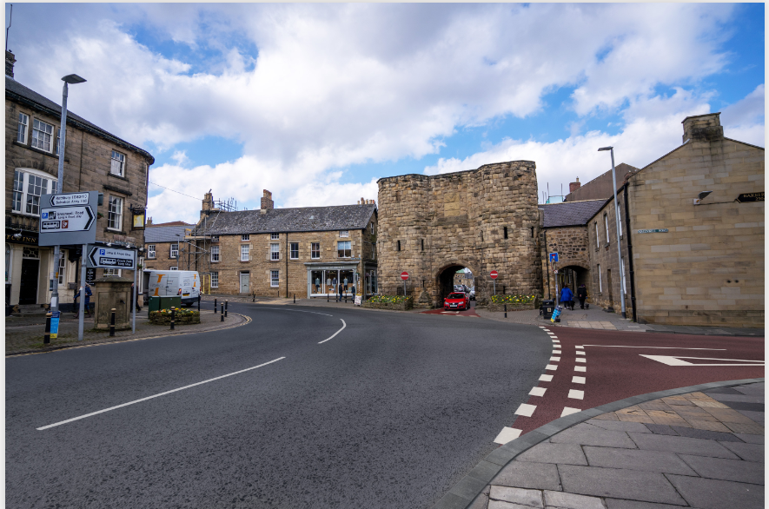

Slide 16
Option 3: Full Closure to vehicular traffic
Kerbs and bollards on both sides of the tower to prevent vehicle access.
Associated signing strategy to re-route vehicles.
Bondgate Without/Hotspur Street becomes through route.
Turning circle provided in Bondgate Within
Large vehicles still require 3-point turn.
Eliminates potential for vehicle strikes.
Significant impact on traffic elsewhere in the town

Slide 17
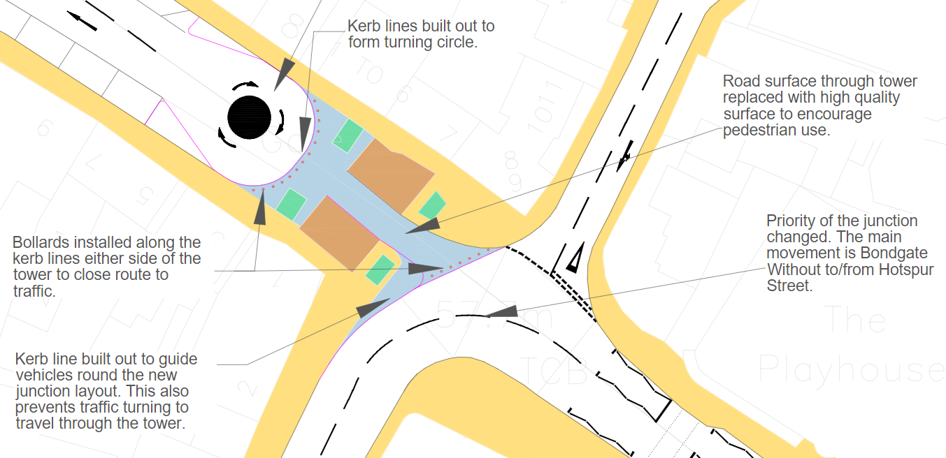

Slide 18
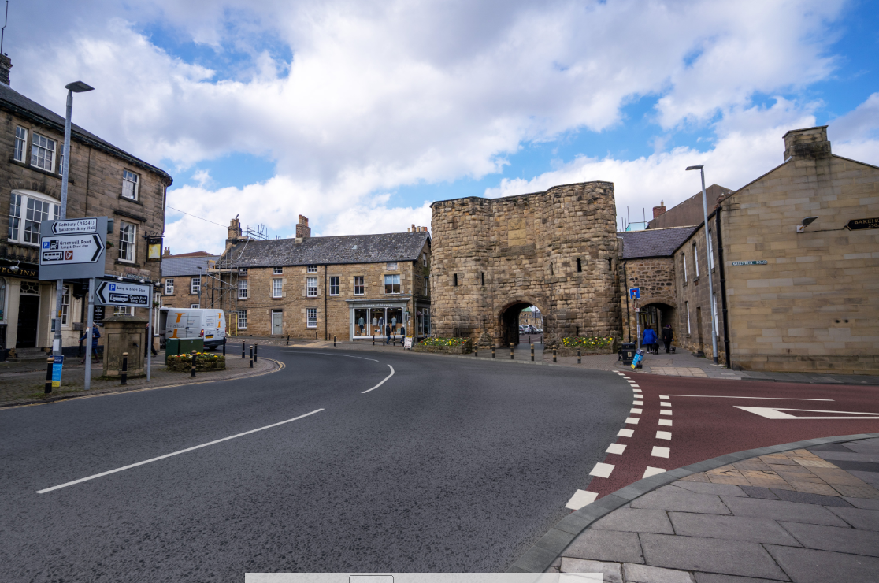

Slide 19
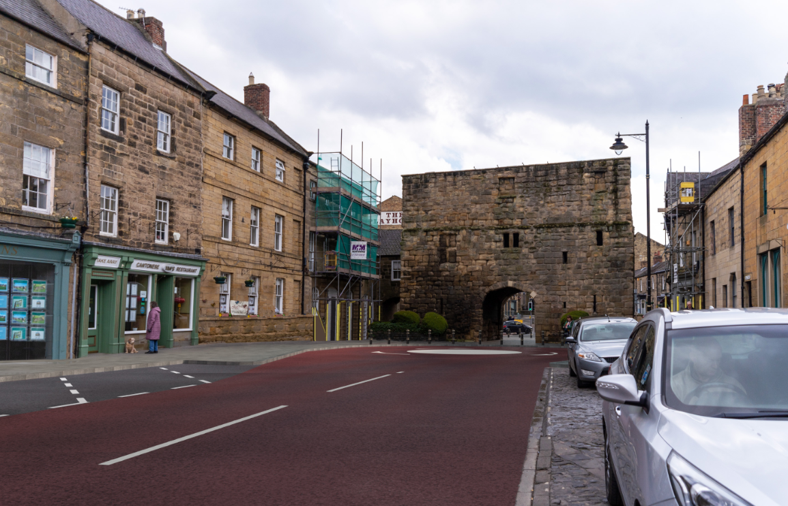

Slide 20
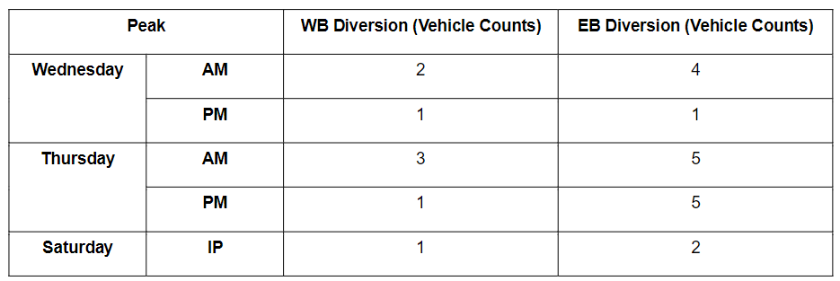
Re-routing
Option 1 (signage):
Limited amount of additional traffic on diversion routes due to better signing which may encourage all large vehicles to avoid the tower, including those that could pass through.

Slide 21
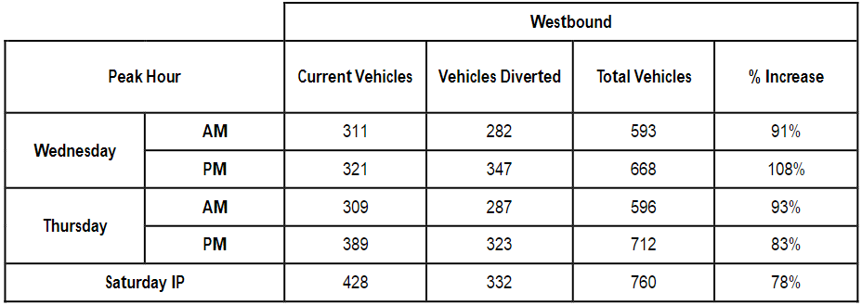
Option 2: Closure in one direction:
Significant additional westbound traffic.

Slide 22
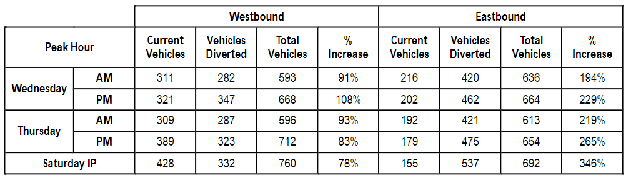
Option 3: Full closure
Extremely large increase in traffic in both directions on the diversion routes.

Slide 23
Mitigation
Mitigation will be required on both diversion routes. The following can be expected to become pinch points:
Tower Lane/Clayport Street junction
Lisburn Terrace/Clayport Street junction
Prudhoe Street/South Road junction – mitigation may have to encompass Denwick Lane junction.
Narrow section of Hotspur Street near Hotspur Place
Narrow section at the west end of Green Batt
Parking restrictions needed along Lisburn Street to create passing places.
Full traffic modelling required.

Slide 24
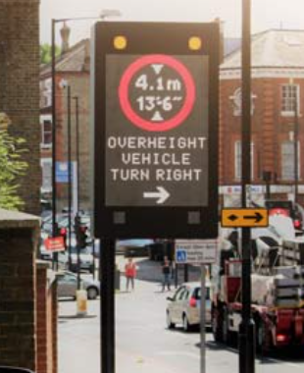
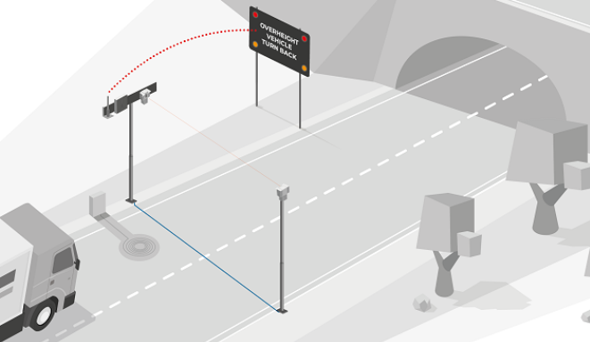
Height Detection Technology & Vehicle Activated Signs
Detectors on each approach.
Sign triggered when large vehicles detected.
Sign shows height restriction and diversion route.

Slide 25
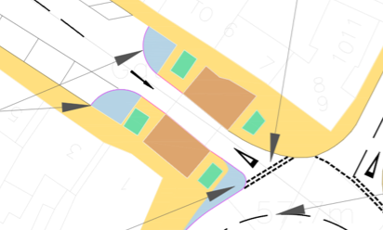
Kerb Realignment
Change existing kerblines to direct traffic centrally through the arch

Slide 26
Other measures considered
Improved lighting of the tower.
Could be considered as a way of highlighting the tower and its arch.
More likely to be a 'conservation' type feature, e.g. uplighting.
Potential for provision of LED lighting within the arch.
Physical height restriction measures, e.g. arch in advance of the tower.
Could not be attached to the tower.
Would need to be decorative to be acceptable in the historic environment.
Decorative arch unlikely to be accepted as a 'sacrificial' feature.
Very limited scope for an arch on the Bondgate Without side.
Introduces an additional risk into the area.

Slide 27
Study Recommendations
Implement Option 1 (signage).
Height detection system be considered.
Kerb realignment be implemented.
Lighting within the arch be considered.
Option 3 (full closure) be considered further, including full traffic modelling.

Slide 28
NCC Recommendations
Implement Option 1 (signage).
Height detection system be considered, once option 1 has had time to ‘bed in’.
Kerb realignment be implemented.
Full/Partial closure discounted due to unacceptable impact on diversion routes.

Slide 29
Questions?

